Slide 1
Test Data Set
Data Platform RFP
John Platten

Slide 2
Intent
The intent of the Test Data Set is to provide vendors with a common source from which to tell us
a story about the data’s journey from raw source to analytics, pausing along the way to touch on topics such as project management, standardisation, transformation, alerting and monitoring, data quality, preparation for analytics, and reporting.
This can be summarised as:
“it’s not whether the test data set arrives in a report - it’s how”

Slide 3
Business Scenario
An IPC distributor buys 3 products from 3 suppliers. They send one Purchase Order a week to each supplier, for seven weeks; comprising 21 EDI order messages overall.
Each purchase order is sent by EDIFACT EDI and acted upon by the supplier in the normal manner.
In parallel the message content is harvested by an IPC EMEA Data Exchange Platform and converted from the original EDI to a JSON format that:
Removes complexities such as segment headings from the original EDI message
Focusses on relevant data only
Standardises the json field output, irrespective of supplier
The 21 Purchase Order JSONs have been passed to you, IPC EMEA’s Data Platform partner, to prepare analytics and discuss anomalies with us, so we may use the output to gain business insight on how our supply chain is functioning.

Slide 4
Data Scenario
For the purposes of a simple demonstration
Only a few fields are present. A real Purchase Order .json would likely have considerably more content.
Only the Purchase Order message type is present. A real business interchange would have PO acknowledgements, advance delivery notes…
Two of the suppliers (Meaty Co and Protein Inc) have been sent well-formed messages with no data errors that we are aware of. The third (Poor DQ Ltd. ) are sent badly formed messages. The problem messages have been deliberately constructed and separated out to support your demonstrations of data quality, monitoring and alerting.
You should upload the POs for two companies with good data, take them through to a simple Power BI reporting outcome; demonstrating how you would have controlled and achieved this result in a live situation.
You should load the Bad DQ messages in a manner that demonstrates how you would deal with problem data in a live scenario. You do not need to add a corrected result to the reporting layer. The third company is primarily a test scenario of monitoring and alerting.

Slide 5
Product & Price Masters
Small product and price masters is provided to support an extremely simple demo of transformation where they are looked up, joined with the JSON data set and displayed in BI reports:
GTIN | PRODUCT_NAME | UOM
30825146072077 | Sliced Ham | Case
30825146072503 | Salami | Case
30825146073654 | Pepperoni | Case
GTIN | IPC Mandated Price | Price Type | Effective Date
30825146072077 | 7.74 | Original | 01/01/2024
30825146072503 | 7.98 | Original | 01/01/2024
30825146073654 | 6.78 | Original | 01/01/2024
30825146072077 | 7.88 | Price Increase | 08/05/2024

Slide 6
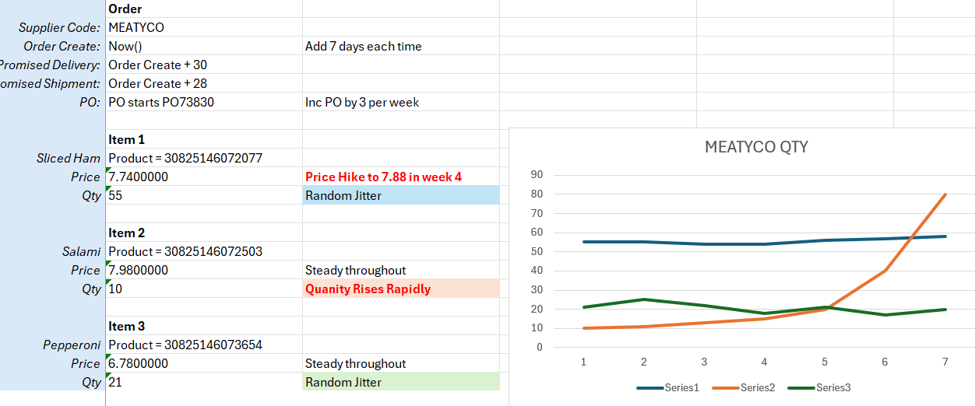
Supplier : MEATY CO
MeatyCo have been sent only good purchase orders by the distributor
They will ship at 28 days from Order
Delivery is expected at 30 days from Order
The product Sliced Ham (GTIN:30825146072077) receives a price rise in week 4, per the pricing master
The DC experience a strong demand for Salami (GTIN:30825146072503) during the 7 weeks and escalate their orders with MeatyCo in response.

Slide 7
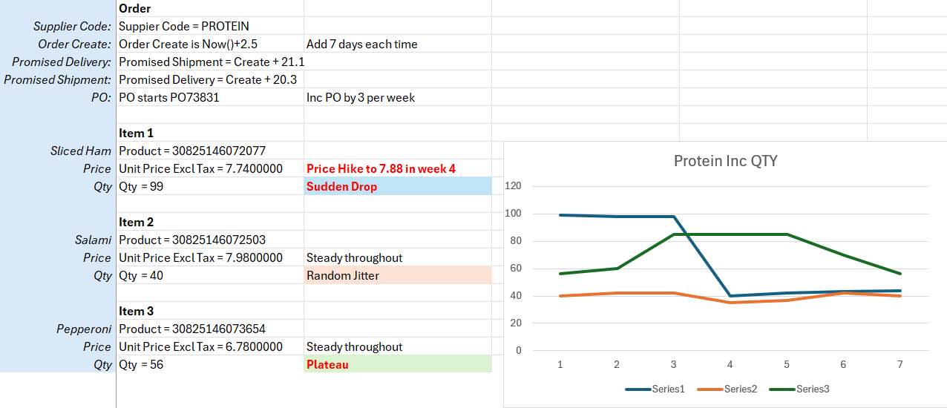
Supplier : PROTEIN INC
Protein Inc have been sent only good purchase orders by the distributor. Their purchase orders are generally larger than those going to Meaty Co.
They will deliver at 21 days and ship at 20 days but are allocated a few extra hours for processing.
The product Sliced Ham (GTIN:30825146072077) receives an IPC mandated price rise in week 4, per the pricing master. The distributor reassesses how much they are ordering and drops their order quantity.
The DC experience a transient demand spike for Pepperoni (GTIN:30825146072503) during the 7 weeks that causes them to order more from Protein Inc. The increased demand plateaus, then returns to normal.

Slide 8
Supplier : POOR DQ LTD
Due to system and user input issues with a potential new supplier Poor DQ Ltd have been sent good purchase orders for only the first two weeks, but the distributor has made a considerable number of errors into weeks 3-7 which should be detected and highlighted back to the Supplier Performance Manager and Distributor Performance manager. [One set of DQ reports, and no need to correct the data and add it to analytics]
Week | Order | Item | Field | Fault
3 | PO73835 | n/a | marketplace_order_id | Purchase order number duplicates week two. Should have been PO73838.
3 | PO73835 | n/a | Filename | As the PO is part of the filename it is also impacted should have been: 20240504-POORDQ-PO73838
4-7 | multi | 30825146072077 | unit_price_exl_tax | The DC failed to apply the IPC mandated Sliced Ham price hike to 7.88 that it should have in week 4.
5 | PO73844 | 30825146073654 | Qty | 45A is not a number. Should have been 45.
6 | PO73847 | 30825146073654 | Price | Missing. Should be 6.78
7 | PO73850 | n/a | promised_delivery_date promised_shipment_date | Promised delivery is sooner than promised shipment

Slide 9
The Restated Order Excercise
The distributor sent MeatyCo a purchase order PO73830 on 2024-04-17 that included a line for 55 units of Salami. They realise a day later that this was incorrect and should have been 50 units. A purchase order amendment is sent that updates the value within the suppliers permitted notification period. All other details remain the same.
Your demonstration objective is to locate and update the purchase order within your purchase orders delta table rather than storing it as a new purchase order or rejecting it as a duplicate. You will need to observe the filename, date fields and order type of the file to achieve this.
The changed details are as follows:
 | File | Order_type | For the Item | qty =
Bad Order | 20240417-MEATYCO-PO73830.json | 0 = Original | 30825146072077 | 55
Correction | 20240417-MEATYCO-PO73830_1.json | 1 = up-versioned | 30825146072077 | 50

Slide 10
Extending the Data Set to Highlight Additional USPs
The base RFP requirement is to process the two clean companies to analytics and demonstrate data quality
controls and alerting on the third.
However –
It is permissible to extend the JSONs if there is a particular facility or feature of your frameworks that you wish to highlight, and that will require more data than we have provided. You do not require our further permission to do this and can create additional suppliers, items, fields and scenarios as you wish.
If you require assistance with .json data creation in a similar style to the original scenarios we have built a utility that can help you do this. We are not evaluating your ability to create test data. Use of the tool is free of any RFP vendor scoring implications. Contact Toby Hudson for details.

